Slide 1

Smart Solutions in Waste Management Real-Time Route Optimization Through AI
Kalyan Pothineni
DSC630-T301 (2245-1) Predictive Analytics
05/29/2024

Slide 2
Introduction
Implementing IoT sensors: IoT sensors track waste levels, enabling data-driven decision-making and efficient resource allocation.
Integration of predictive analytics: Predictive analytics forecast waste generation patterns, facilitating proactive waste management strategies.
Machine learning for sorting processes: Machine learning algorithms enhance waste sorting accuracy, improving recycling efficiency and reducing contamination.

Slide 3
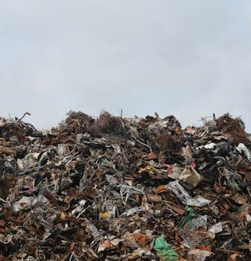
Problem Statement
Inadequate infrastructure for waste segregation: Insufficient facilities hinder effective separation of recyclables, leading to higher contamination rates.
Limited public awareness on proper disposal methods: Lack of education and outreach results in improper waste disposal practices that undermine recycling efforts.
Challenges in integrating diverse waste management systems: Coordinating various waste collection methods complicates overall operational efficiency and standardization processes.

Slide 4

Solution Overview
AI-enhanced route optimization: AI optimizes waste collection routes, minimizing fuel consumption and reducing operational costs.
IoT-enabled smart bins: IoT sensors in bins monitor fill levels, enhancing waste collection efficiency and preventing overflow.
AI-IoT synergy for predictive maintenance: Combining AI predictions with IoT sensor data enables timely equipment maintenance, ensuring uninterrupted waste services.

Slide 5

Data Preparation
Data cleaning and preprocessing: Removing duplicates and handling missing values ensures dataset accuracy for reliable analysis.
Feature engineering for model inputs: Creating new features improves model performance by capturing relevant patterns in waste data.
Splitting dataset for training and testing: Partitioning data enables validation of predictive models, ensuring generalizability to unseen waste scenarios.

Slide 6
Modeling Techniques
Random Forest Regressor Model: Ensemble learning technique combines multiple decision trees to optimize waste collection route predictions.
Improved prediction accuracy: Random Forest captures complex relationships in waste data, enhancing route planning precision.
Robust against overfitting: Model's ability to handle large datasets reduces overfitting risks for more reliable forecasts.

Slide 7
Results - Data Visualization
Fill Level Analysis Graphs: Visualizing fill levels aids in identifying optimal collection times and prevents overflow.
Fuel Consumption Trends Visualization: Monitoring fuel consumption patterns informs adjustments for cost-effective operations and sustainability.
Route Efficiency Mapping: Mapping route efficiency enhances service optimization, reducing time and resource wastage.

Slide 8
Model Performance Overview
Model Used: Random Forest Regressor
Mean Squared Error (MSE): Approximately 0.00002055
R² Score: 0.99999
Visual Summary

Slide 9
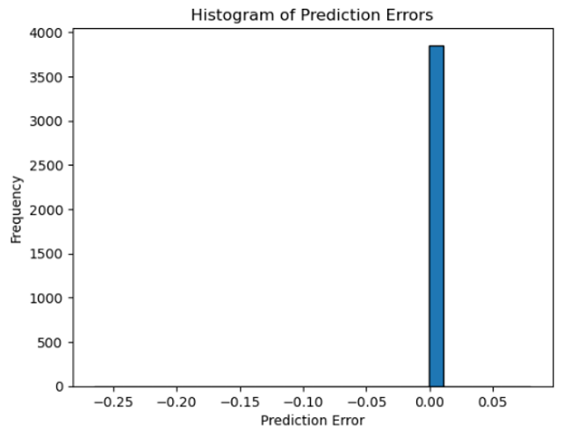
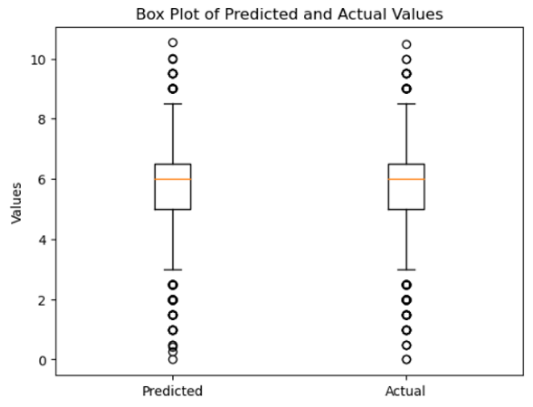
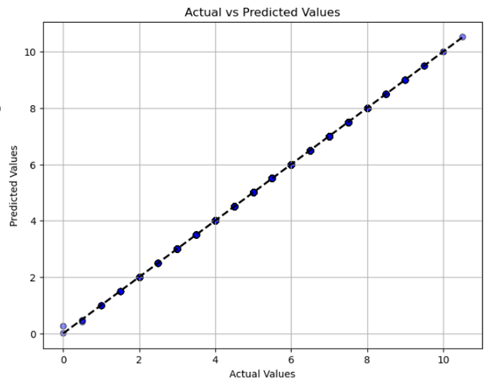
Visualizations
Actual Vs Predicted Values: Actual volume relationship. Indicating model is highlt accurate
Error Prediction: Prediction Errors presents a highly concentrated distribution around Zero. Suggesting the model is highly accurate
Distribution: Box plot displays the distribution of the predicted and actual values with similar medians and interquartile ranges

Slide 10

Feature Importance
Incorporation of Weather Data: Integrating weather information enhances route optimization by adapting to seasonal variations and minimizing delays.
Dynamic Traffic Analysis: Real-time traffic data improves collection schedules, reducing emissions and optimizing resource allocation.
Customer Feedback Integration: Integrating feedback loop from customers enhances service personalization, increasing efficiency and satisfaction.

Slide 11
Implementation and Impact
Cost Savings and Efficiency: Waste management optimization project reduces operational costs and streamlines collection processes for financial benefits.
Resource Allocation Improvement: Optimization enhances allocation of resources, minimizing waste overflow and ensuring timely collections.
Sustainable Practices Promotion: Efficient waste management promotes sustainability goals by reducing carbon footprint and enhancing environmental stewardship.

Slide 12
Future Directions
Integration of Advanced Robotics: Robotic technology automates waste sorting and processing tasks, improving efficiency and reducing human error.
Blockchain for Supply Chain Transparency: Utilizing blockchain ensures traceability of waste movement, enhancing accountability and promoting circular economy principles.
Community Engagement Initiatives: Involving communities in waste management decisions fosters sustainability awareness and encourages active participation for long-term success.

Slide 13

Conclusion
Efficient Resource Allocation: Optimized waste collection routes reduce fuel consumption, saving costs and promoting sustainability.
Enhanced Operational Responsiveness: Real-time data enables immediate adjustments in waste operations for improved efficiency.
Promotion of Sustainable Practices: Smart waste management reduces carbon footprint, aligning with environmental stewardship goals.

